Slide 1


Computer Graphics
Multimedia Systems and Compression
Lecture- 9, 10
Md Mehefujur Rahman Mubin
Department of Computer Science and Engineering
Daffodil International University, DIU
Department of CSE, Daffodil International University
1
Notes:
[Sources] - Visual style adapted from uploaded file: Lecture-3_DDA Algorithm_new.pptx.pdf. - Topic sequencing and compression terminology adapted from uploaded file: Week 5 - Image Compression (1).pdf. [/Sources]

Slide 2
Learning Outcomes
Explain what a multimedia system is and why compression is necessary.
Differentiate data, information, redundancy, compression ratio, lossless and lossy compression.
Apply Huffman coding to build codes, compute average bit length and estimate compression ratio.
Describe the full JPEG pipeline and solve basic quantization / zigzag style exercises.
Explain MPEG video compression using I, P and B frames, motion vectors and residual error.
Practice exam-style problems at the end of each topic.
How to use this deck
Study concept -> see worked example -> solve practice problem -> check whether you can explain the idea in your own words.
Department of CSE, Daffodil International University
2
Notes:
[Sources] - Learning goals synthesized by assistant from the user-requested topics and Week 5 - Image Compression (1).pdf. [/Sources]

Slide 3
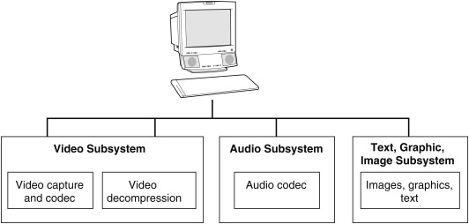
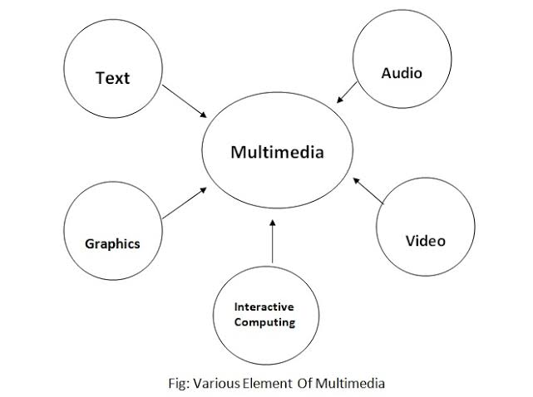
1. Multimedia System
Start from the big picture before learning compression.
Department of CSE, Daffodil International University
3
Notes:
[Sources] - Visual style adapted from uploaded file: Lecture-3_DDA Algorithm_new.pptx.pdf. [/Sources]

Slide 4
What is a Multimedia System?
Definition
Capture
Store
Compress
Transmit
Decode
A multimedia system is a computer-based system that stores, processes, transmits and presents multiple media types together: text, graphics, image, audio, video and animation.
Typical components
Present
Input devices: camera, microphone, scanner
CPU/GPU for processing
Storage: SSD/HDD/cloud
Network for delivery
Display and speakers for output
Why it matters in computer graphics
Graphics is only one component. In a real application, a scene may include image, sound, video clips, subtitles, timing control and user interaction.
Department of CSE, Daffodil International University
4
Notes:
[Sources] - Multimedia system definition and compression motivation synthesized by assistant for teaching use. [/Sources]

Slide 5
Characteristics of a Multimedia System
Technical characteristics
Real-life examples
Integration of several media types in one application.
Time-dependent data: audio and video must play at the correct rate.
Large data volume: raw image, audio and video consume significant storage.
Synchronization is essential: lip movement and sound should match.
Interactive control: pause, rewind, zoom, seek, click, drag.
YouTube: video + audio + subtitles + thumbnails + controls.
Online class: slides + camera feed + microphone + screen share.
Game: 3D graphics + animation + background music + effects.
Medical imaging system: image archive + annotations + video clips.
Google Maps street view: image, text and voice navigation.
Department of CSE, Daffodil International University
5
Notes:
[Sources] - Compression definitions and terminology adapted from Week 5 - Image Compression (1).pdf. - Example applications and characteristics are standard educational examples synthesized by assistant. [/Sources]

Slide 6
Why Compression is Necessary in Multimedia
Raw data grows very fast
Media item | Simple raw size estimate | Meaning
1024 × 1024 grayscale image | 1024×1024×8 bits = 8,388,608 bits ≈ 1 MB | One still image
1920 × 1080 RGB frame | 1920×1080×24 bits ≈ 49,766,400 bits ≈ 5.93 MB | One full-color frame
30 fps Full HD video | 5.93 MB × 30 ≈ 178 MB/s | Much too large for ordinary storage/streaming
CD-quality audio (stereo) | 44,100 samples/s × 16 bits × 2 ≈ 1.41 Mb/s | Large for long recordings
Main reason
Quick check
Compression reduces storage, transmission time, bandwidth and cost while trying to keep useful information.
If one raw 4 MB image must be sent over a slow network, what happens if you compress it to 0.5 MB? Answer: less bandwidth, faster transfer, lower storage.
Department of CSE, Daffodil International University
6
Notes:
[Sources] - Compression motivation and terminology adapted from Week 5 - Image Compression (1).pdf pages 2-10. - Raw size examples are computed by assistant from standard size formulas. [/Sources]

Slide 7
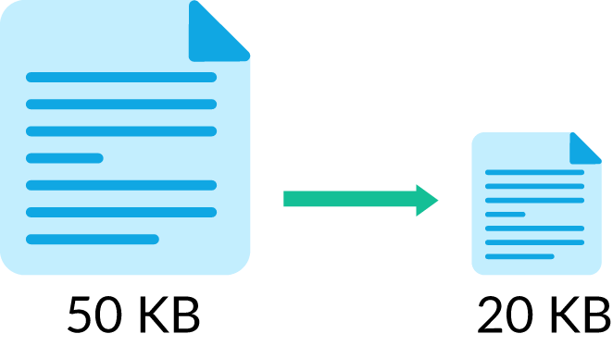
2. Data Compression Basics
Before JPEG and MPEG, learn redundancy and measurement.
Department of CSE, Daffodil International University
7
Notes:
[Sources] - Visual style adapted from uploaded file: Lecture-3_DDA Algorithm_new.pptx.pdf. [/Sources]

Slide 8
Data, Information and Redundancy
Data
Information
Redundancy
Raw symbols or values stored in a computer. For an image, pixel intensities are data.
Meaning extracted from the data. Different data representations may contain the same useful information.
Extra or repeated data that is not necessary for representing the same information.
Key idea: data is not always equal to information.
Example
Consider 8 pixels: 120,120,121,120,120,121,120,120.
They carry nearly the same visual information. A smart coding method can represent this more compactly than storing each value independently.
If neighboring pixels are almost the same, storing each one independently wastes bits.
If a symbol appears very often, giving every symbol the same bit length is inefficient.
If the human eye cannot notice a tiny change, storing that detail exactly may be unnecessary in lossy compression.
Department of CSE, Daffodil International University
8
Notes:
[Sources] - Definitions adapted from Week 5 - Image Compression (1).pdf pages 2 and 11-12. [/Sources]

Slide 9
Types of Redundancy
1. Coding redundancy
2. Spatial / temporal redundancy
3. Psychovisual redundancy
Some symbols occur much more often than others. Fixed-length code wastes bits.
Example: If A appears 70% of the time and Z appears 1% of the time, giving both 8 bits is inefficient. Variable-length coding such as Huffman helps here.
Some details are less noticeable to the human eye. Lossy methods remove or coarsen them.
Example: slight high-frequency chroma detail in JPEG.
Neighboring pixels in an image are often similar. Nearby video frames are also similar.
Example: blue sky across many pixels, or a person slightly moving between frames.
Question: Which redundancy is mainly reduced by Huffman coding? Which by MPEG motion compensation? Which by JPEG quantization?
Department of CSE, Daffodil International University
9
Notes:
[Sources] - Redundancy types adapted from Week 5 - Image Compression (1).pdf pages 11-15. [/Sources]

Slide 10
Lossless vs Lossy Compression
Feature | Lossless | Lossy
Can reconstruct original exactly? | Yes | No
Main idea | Remove redundancy without losing information | Remove redundancy + discard less-important information
Typical methods | Huffman, Run-Length, PNG, ZIP | JPEG, MPEG, MP3
Typical use | Text, medical records, source code, archival | Photos, video, streaming, social media
Compression ratio | Usually lower | Usually higher
Remember
Question
Lossless means exact recovery. Lossy means acceptable recovery based on perception or application requirement.
Why is JPEG preferred for photographs but not for source code or legal documents?
Department of CSE, Daffodil International University
10
Notes:
[Sources] - Compression type distinction adapted from Week 5 - Image Compression (1).pdf page 10. [/Sources]

Slide 11



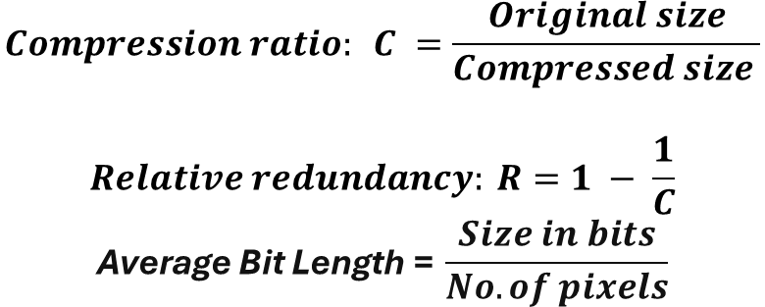
Compression Ratio and Redundancy: Math
Formulas
Worked example
An image size is 16 × 16 pixels. After applying compression, the total size becomes 720 bits.
$$C = \frac{720}{16×16}=2.81≈3$$
Therefore, the average number of bits required to represent each pixel is 3 bits/pixel.
$$Compression ratio: C =\frac{Original size}{Compressed size }$$
$$Relative redundancy: R=1 − \frac{1}{C}$$
$$\text{Average} \text{Bit} \text{Length}\text{ =} \frac{Size in bits}{No. of pixels}$$
Worked example
Practice problem
An image size is 65,536 bytes. After compression it becomes 6,554 bytes.
$$C = \frac{65,535}{6554} ≈ 10 \\ R = 1−\frac{1}{10}= 0.9$$
So, we say the image has about 10:1 compression and 90% relative redundancy.
A raw image is 2.4 MB and the compressed image is 0.3 MB.
1) Find the compression ratio.
2) Find the relative redundancy.
Solution outline:
$$C = \frac{2.4}{0.3}= 8 \\ R = 1−\frac{1}{8} = 0.875 = 87.5\%$$
Department of CSE, Daffodil International University
11
Notes:
[Sources] - Compression ratio and redundancy formulas adapted from Week 5 - Image Compression (1).pdf pages 6-9. [/Sources]

Slide 12
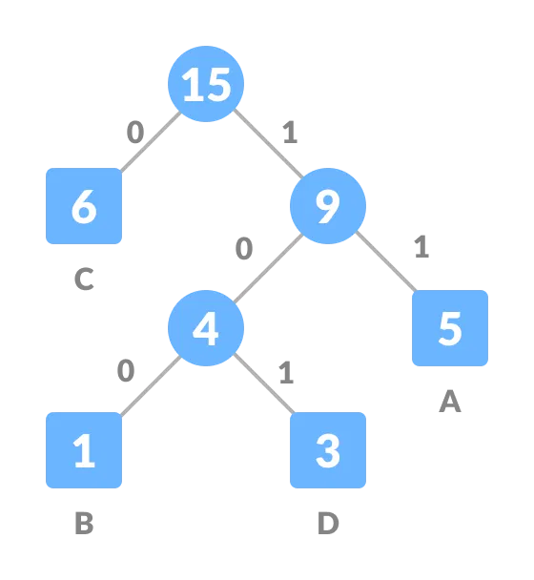
3. Huffman Coding
The classic lossless coding technique you should be able to solve by hand.
Department of CSE, Daffodil International University
12
Notes:
[Sources] - Visual style adapted from uploaded file: Lecture-3_DDA Algorithm_new.pptx.pdf. [/Sources]

Slide 13
Huffman Coding: Main Idea
Definition
Huffman coding is a lossless variable-length coding technique. It assigns short codes to frequent pixels and longer codes to rare pixels.
Compare fixed vs variable length
Suppose four pixels use equal 2-bit fixed code. If one pixel appears much more often, variable-length coding can lower the average below 2 bits/pixel.
Why it works
If common pixels use fewer bits, the average number of bits per symbol decreases. That means lower storage while preserving exact information.
Department of CSE, Daffodil International University
13
Notes:
[Sources] - Huffman coding introduction adapted from Week 5 - Image Compression (1).pdf pages 23-27. [/Sources]

Slide 14
Huffman Coding Algorithm
Step-by-step algorithm
Count the frequency of each pixel value.
2. Put all pixel values into a min-priority queue.
3. Remove the two nodes with smallest frequency.
4. Combine them into a new parent node whose frequency is the sum.
5. Insert the parent back into the queue.
6. Repeat until one root remains.
7. Assign 0 to each left edge and 1 to each right edge.
8. The root-to-leaf path gives the code for each symbol.
Time-saving exam tip
In the exam, always write frequencies in descending order first. Then combine the two smallest repeatedly.
Important property
No Huffman code is a prefix of another Huffman code. Therefore, the bitstream can be decoded unambiguously.
Department of CSE, Daffodil International University
14
Notes:
[Sources] - Algorithm steps adapted from Week 5 - Image Compression (1).pdf pages 25-27. [/Sources]

Slide 15
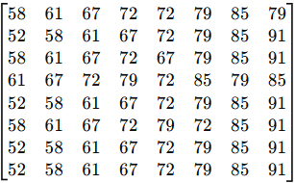
Worked Example: Build a Huffman Tree
Pixel values Frequency
Given an image: 8*8 8-bit grayscale image
Gray level | Frequency
52 | 4
58 | 7
61 | 8
67 | 10
72 | 11
79 | 10
85 | 9
91 | 5
What to remember
Total Number of pixel in the image: 8x8 = 64. [Original Storage: (Total no. of pixel * bit) = 64*8 = 512 bits]
Sum of the frequency: 4+7+8+10+11+10+9+5=64
Since, the total number of pixel and sum of the frequency are equal. Hence, the histogram is correct
Department of CSE, Daffodil International University
15
Notes:
[Sources] - Huffman process follows the algorithm in Week 5 - Image Compression (1).pdf pages 25-27. - Frequency example A:45, B:13, C:12, D:16, E:9, F:5 is a standard teaching example synthesized by assistant. [/Sources]

Slide 16
Worked Example: Build a Huffman Tree
Sort the frequency of pixel values in descending order to construct the Huffman tree
Combine the two nodes with smallest frequency into a new parent node whose frequency is the sum
Rearrange the nodes after making a new node
11
10
10
9
8
7
5
4
72 79 67 85 61 58 91 52
Note:
Since 4 and 5 are the two lowest frequencies, we combine them to form a new parent node. The value of the parent node is the sum of these two values: 9.
Department of CSE, Daffodil International University
15
Notes:
[Sources] - Huffman process follows the algorithm in Week 5 - Image Compression (1).pdf pages 25-27. - Frequency example A:45, B:13, C:12, D:16, E:9, F:5 is a standard teaching example synthesized by assistant. [/Sources]

Slide 17
Worked Example: Build a Huffman Tree
Sort the frequency of pixel values in descending order to construct the Huffman tree
Combine the two nodes with smallest frequency into a new parent node whose frequency is the sum
Rearrange the nodes after making a new node
9
11
10
10
9
8
7
5
4
72 79 67 85 61 58 91 52
Note:
Now, lowest two nodes are 7 and 8. So, make a new parent nodes: 7+8=15
Department of CSE, Daffodil International University
15
Notes:
[Sources] - Huffman process follows the algorithm in Week 5 - Image Compression (1).pdf pages 25-27. - Frequency example A:45, B:13, C:12, D:16, E:9, F:5 is a standard teaching example synthesized by assistant. [/Sources]

Slide 18
Worked Example: Build a Huffman Tree
Sort the frequency of pixel values in descending order to construct the Huffman tree
Combine the two nodes with smallest frequency into a new parent node whose frequency is the sum
Rearrange the nodes after making a new node
15
9
11
10
10
9
8
7
5
4
72 79 67 85 61 58 91 52
Note:
Since 9 and 9 are now the smallest nodes, we place them side by side for convenience so they can be merged into a new parent node.
Department of CSE, Daffodil International University
15
Notes:
[Sources] - Huffman process follows the algorithm in Week 5 - Image Compression (1).pdf pages 25-27. - Frequency example A:45, B:13, C:12, D:16, E:9, F:5 is a standard teaching example synthesized by assistant. [/Sources]

Slide 19
Worked Example: Build a Huffman Tree
18
15
9
11
10
10
8
7
9
5
4
72 79 67 61 58 85 91 52
Note:
Among 11, 10, 10, 15, and 18; node 10 and 10 are the smallest.
Department of CSE, Daffodil International University
15
Notes:
[Sources] - Huffman process follows the algorithm in Week 5 - Image Compression (1).pdf pages 25-27. - Frequency example A:45, B:13, C:12, D:16, E:9, F:5 is a standard teaching example synthesized by assistant. [/Sources]

Slide 20
Worked Example: Build a Huffman Tree
18
20
15
9
11
10
10
8
7
9
5
4
72 79 67 61 58 85 91 52
Note:
Again, 11 and 15 are now the smallest nodes. So, we again place them side by side for convenience so they can be merged into a new parent node.
Department of CSE, Daffodil International University
15
Notes:
[Sources] - Huffman process follows the algorithm in Week 5 - Image Compression (1).pdf pages 25-27. - Frequency example A:45, B:13, C:12, D:16, E:9, F:5 is a standard teaching example synthesized by assistant. [/Sources]

Slide 21
Worked Example: Build a Huffman Tree
26
18
15
20
9
11
8
7
10
10
9
5
4
72 61 58 79 67 85 91 52
Note:
Merge 18 and 20 as these two are now the smallest two nodes.
Department of CSE, Daffodil International University
15
Notes:
[Sources] - Huffman process follows the algorithm in Week 5 - Image Compression (1).pdf pages 25-27. - Frequency example A:45, B:13, C:12, D:16, E:9, F:5 is a standard teaching example synthesized by assistant. [/Sources]

Slide 22
Worked Example: Build a Huffman Tree
38
26
18
15
20
9
11
8
7
10
10
9
5
4
72 61 58 79 67 85 91 52
Note:
Finally, merge 26 and 38 to form the root node, whose value is 64. This matches the total sum of all frequencies, which is 64. Since the image size is 8×8, the total number of pixels is also 64.
Department of CSE, Daffodil International University
15
Notes:
[Sources] - Huffman process follows the algorithm in Week 5 - Image Compression (1).pdf pages 25-27. - Frequency example A:45, B:13, C:12, D:16, E:9, F:5 is a standard teaching example synthesized by assistant. [/Sources]

Slide 23
Worked Example: Build a Huffman Tree
64
38
26
18
15
20
9
11
8
7
10
10
9
5
4
72 61 58 79 67 85 91 52
Note:
Now assign 0 to the left edge and 1 to the right edge.
Department of CSE, Daffodil International University
15
Notes:
[Sources] - Huffman process follows the algorithm in Week 5 - Image Compression (1).pdf pages 25-27. - Frequency example A:45, B:13, C:12, D:16, E:9, F:5 is a standard teaching example synthesized by assistant. [/Sources]

Slide 24
Worked Example: Build a Huffman Tree
Pixel Values | Codes | Bits | Freq. | Total (bit size x freq)
72 | 00 | 2 | 11 | 22
61 | 010 | 3 | 8 | 24
58 | 011 | 3 | 7 | 21
79 | 100 | 3 | 10 | 30
67 | 101 | 3 | 10 | 30
85 | 110 | 3 | 9 | 27
91 | 1110 | 4 | 5 | 20
52 | 1111 | 4 | 4 | 16
64
0
1
38
1
0
26
18
1
1
0
0
15
20
9
0
1
0
1
0
1
11
8
7
10
10
9
5
4
72 61 58 79 67 85 91 52
Note:
After applying Huffman coding, the size of the image becomes: 22+24+21+30+30+27+20+16 = 190 bits
Department of CSE, Daffodil International University
15
Notes:
[Sources] - Huffman process follows the algorithm in Week 5 - Image Compression (1).pdf pages 25-27. - Frequency example A:45, B:13, C:12, D:16, E:9, F:5 is a standard teaching example synthesized by assistant. [/Sources]

Slide 25
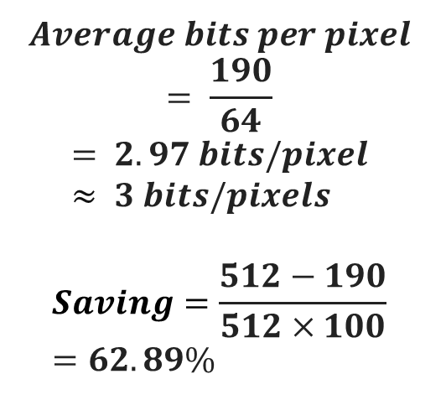
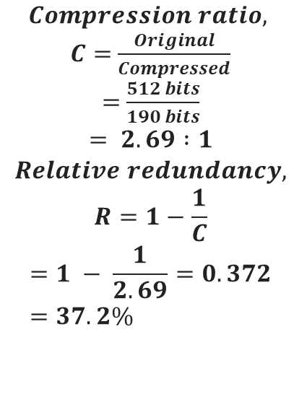
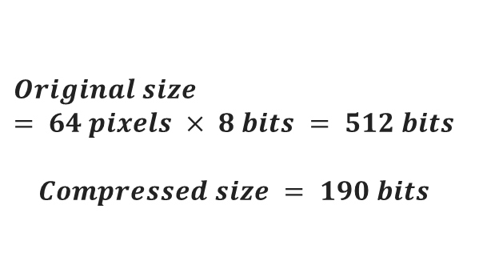
Original vs compressed
Compression ratio
Bits per pixel and saving
$$Original size = 64 pixels × 8 bits = 512 bits$$
$$Compressed size = 190 bits$$
$$Compression ratio,$$
$C=$ $\frac{Original}{Compressed}$
$=$ $\frac{512 bits}{190 bits}$
$$= 2.69 :1$$
$$Relative redundancy,$$
$$R=1−\frac{1}{C}$$
$$=1 − \frac{1}{2.69}=0.372=37.2\%$$
$$Average bits per pixel \\ = \frac{190}{64} \\ = 2.97 bits/pixel \\ ≈ 3 bits/pixels$$
$$≈ 3 bits/pixels$$
$$Saving=\frac{512−190}{512×100}=62.89\%$$
Conclusion:
Huffman coding keeps the image information exact, but reduces the average storage from 8 bits/pixel to about 3 bits/pixel for this patch
What to remember:
The highest-frequency pixel value 72 gets the shortest code. Rare pixel values 52 and 91 get longer codes. That is why the average bit length decreases.
Department of CSE, Daffodil International University
15
Notes:
[Sources] - Huffman process follows the algorithm in Week 5 - Image Compression (1).pdf pages 25-27. - Frequency example A:45, B:13, C:12, D:16, E:9, F:5 is a standard teaching example synthesized by assistant. [/Sources]

Slide 26


Practice Problem: Solve Huffman Coding by Hand
Problem
Answer outline
A 3x3 10-bit Grayscale image:
$$\left[\begin{matrix}52 & 52 & 52 & 55 \\ 52 & 55 & 55 & 61 \\ 52 & 52 & 61 & 61 \\ 55 & 52 & 61 & 70\end{matrix}\right]$$
Tasks:
1. Draw the Huffman tree.
2. Write one valid code for each pixel.
3. Compute average bits/pixel.
4. Compare with fixed-length coding.
Possible combining order:
4+1=5
5+4=9
9+7=16 (Root)
One valid code set:
52=0, 55=10, 61=110, 70=111
Lengths: 1,2,3,3
$$Avg bits/pixel = \frac{(1×7)+(2×4)+(3×4)+(3×1)}{16} \\ = \frac{30}{16}= 1.875 bits/pixel ≈2 bits/pixel$$
Fixed-length = 10 bit/pixel
Department of CSE, Daffodil International University
17
Notes:
[Sources] - Practice problem and solution synthesized by assistant for exam preparation. [/Sources]

Slide 27
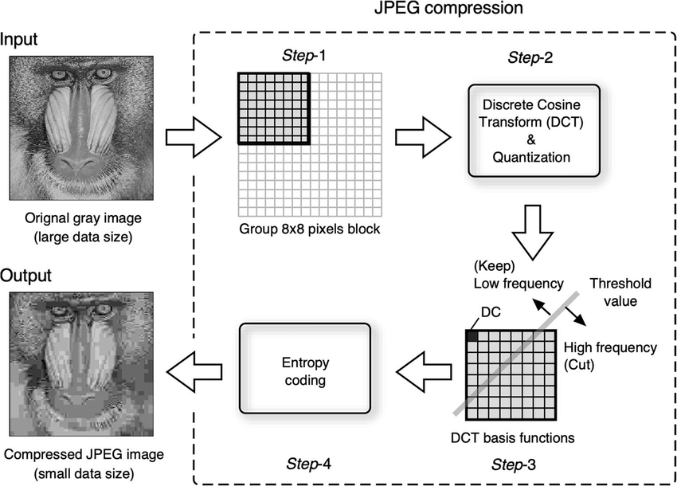
4. JPEG Compression
Most common lossy still-image method. Learn the pipeline.
Department of CSE, Daffodil International University
18
Notes:
[Sources] - Visual style adapted from uploaded file: Lecture-3_DDA Algorithm_new.pptx.pdf. [/Sources]

Slide 28
JPEG at a Glance
What JPEG is
JPEG is a lossy image compression standard designed mainly for natural photographs. It compresses by reducing psychovisual and some statistical redundancy.
RGB → YCbCr
Chroma subsample
8×8 blocks
DCT
Huffman
RLE
Zigzag
Quantize
Why JPEG works well for photos
Human vision is less sensitive to slight high-frequency and color-detail loss than to major brightness loss. JPEG uses this property to save many bits.
Remember the logic
Transform -> quantize -> reorder -> entropy-code. Quantization is the main lossy step.
Department of CSE, Daffodil International University
19
Notes:
[Sources] - JPEG pipeline is standard textbook material synthesized by assistant for teaching use. [/Sources]

Slide 29
JPEG Step 1-3: Color Space and Blocking
1. RGB to YCbCr
3. Divide into 8×8 blocks
Y represents brightness (luminance). Cb and Cr represent color difference (chrominance). JPEG often processes brightness more carefully than color.
The image is split into small 8×8 blocks. Each block is processed separately.
Advantage: localized computation.
Disadvantage: at very high compression, block boundaries may become visible.
2. Chroma subsampling
Because the eye is less sensitive to fine color detail, Cb and Cr may be stored at lower resolution, such as 4:2:0.
Example 8×8 block
Quick concept check
Why can JPEG reduce more color detail than brightness detail? Because human vision notices luminance change more strongly.
Department of CSE, Daffodil International University
20
Notes:
[Sources] - JPEG component descriptions are standard educational material synthesized by assistant for study use. [/Sources]

Slide 30
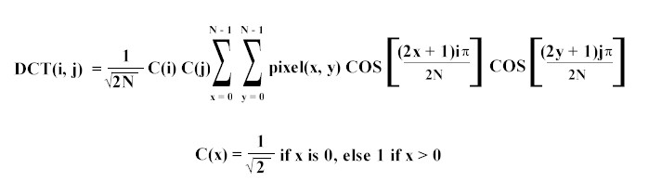
JPEG Step 4: Discrete Cosine Transform (DCT)
Intuition
Low freq
DCT converts pixel values in a block from the spatial domain into frequency coefficients. The top-left coefficient is DC (average brightness). Others are AC (detail / change).
2D DCT idea for an 8×8 block:
High freq
What to remember in exam
You usually do not need to compute the full DCT by hand. You need to know what it does: it packs most visually important energy into a few low-frequency coefficients.
Department of CSE, Daffodil International University
21
Notes:
[Sources] - DCT role in JPEG is standard image-compression material synthesized by assistant. [/Sources]

Slide 31
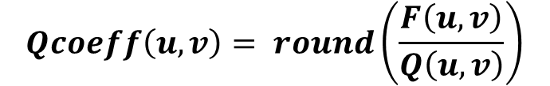
JPEG Step 5: Quantization (Main Lossy Stage)
Quantization formula:
Coefficient F | Q value | Rounded result
160 | 16 | 10
25 | 10 | 3
7 | 14 | 1
3 | 20 | 0
-9 | 17 | -1
Mini exercise
Quantize 52 using Q=13.
Answer: round(52/13)=4
Quantize 6 using Q=20.
Answer: 0
$$Qcoeff\left(u,v\right)= round\left(\frac{F\left(u,v\right)}{Q\left(u,v\right)}\right)$$
Meaning
Large quantization values force many high-frequency coefficients toward zero. This removes fine detail and makes the later coding steps much more efficient.
This is why JPEG is lossy. Once coefficients are rounded, exact recovery is impossible.
Interpretation
After quantization, many small high-frequency values become zero. That makes zigzag + run-length coding very effective.
Department of CSE, Daffodil International University
22
Notes:
[Sources] - Quantization role and formula are standard JPEG teaching content synthesized by assistant. [/Sources]

Slide 32
JPEG Step 6-8: Zigzag, RLE and Huffman
Why zigzag?
1
2
6
7
Run-Length Encoding example
Zigzag order reads low-frequency coefficients first and high-frequency coefficients later. After quantization, the later coefficients are often zero, producing long zero runs.
3
5
8
13
Suppose zigzag output is:
[15, 3, 1, 0, 0, 0, -1, 0, 0, 0, 0]
RLE can store zeros compactly, e.g., (15),(3),(1),(0×3),(-1),(0×4)
4
9
12
14
10
11
15
16
Simplified zigzag order
Final entropy coding
The RLE symbols are then compressed again using Huffman coding. Therefore JPEG combines transform coding + lossy quantization + lossless entropy coding.
Department of CSE, Daffodil International University
23
Notes:
[Sources] - Zigzag, RLE and Huffman roles in JPEG are standard teaching content synthesized by assistant. [/Sources]

Slide 33
JPEG Worked Study Example
Problem
Solution
After DCT, assume a small coefficient sequence is:
[80, 18, 9, 3, 2, 1, 0, 0]
Quantization divisors are:
[8, 6, 9, 10, 12, 15, 20, 25]
Tasks:
1. Quantize each value.
2. Which values become zero?
3. Why does this help compression?
Quantized values:
80/8 = 10
18/6 = 3
9/9 = 1
3/10 ≈ 0
2/12 ≈ 0
1/15 ≈ 0
0/20 = 0
0/25 = 0
Result: [10, 3, 1, 0, 0, 0, 0, 0]
Now the tail has a long run of zeros. Zigzag + RLE + Huffman can compress this very well.
Department of CSE, Daffodil International University
24
Notes:
[Sources] - Study example synthesized by assistant to illustrate JPEG quantization and zero-run formation. [/Sources]

Slide 34
Practice Problems on JPEG
Problem 1
Problem 2
Problem 3
State the major steps of JPEG in correct order.
Expected order:
Color transform -> subsampling -> blocking -> DCT -> quantization -> zigzag -> RLE -> Huffman
Which step of JPEG is lossy?
Why?
Expected answer:
Quantization. Because rounded coefficient values cannot be perfectly recovered.
Why does JPEG work better for photographs than for text diagrams?
Expected idea:
Photos tolerate small smooth losses better; sharp edges in text/artifacts become more visible.
Department of CSE, Daffodil International University
25
Notes:
[Sources] - Practice questions synthesized by assistant for teaching support. [/Sources]

Slide 35
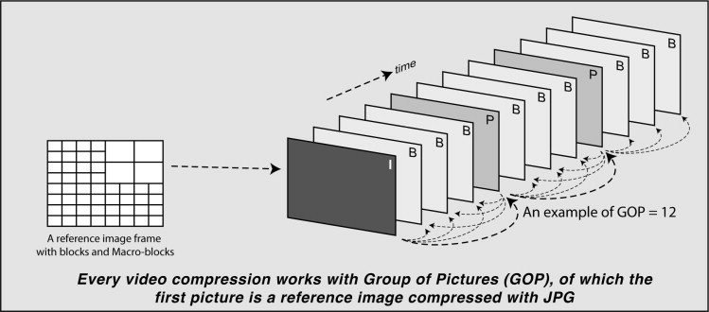
5. MPEG Compression
From image compression to video compression.
Department of CSE, Daffodil International University
26
Notes:
[Sources] - Visual style adapted from uploaded file: Lecture-3_DDA Algorithm_new.pptx.pdf. [/Sources]

Slide 36
From JPEG to MPEG
Core idea
A video is a sequence of frames. If we compressed every frame separately like JPEG, we would ignore the strong similarity between neighboring frames.
Real-world example
A talking person in front of a fixed background: most of the background remains the same from frame to frame. MPEG sends only the important change rather than sending the full frame each time.
MPEG strategy
MPEG combines spatial compression inside each frame and temporal compression across frames. That is why it can achieve much higher video compression.
Department of CSE, Daffodil International University
27
Notes:
[Sources] - MPEG motivation and frame similarity concepts are standard multimedia-compression content synthesized by assistant. [/Sources]

Slide 37
MPEG Frame Types: I, P and B
Frame type | Meaning | Depends on | Use
I-frame | Intra-coded frame | No other frame | Reference, random access, highest size
P-frame | Predicted frame | Previous I/P frame | Stores motion + residual, medium size
B-frame | Bi-directional frame | Previous and next reference frames | Usually smallest, highest compression
Example GOP: I B B P B B P B B I
Think
Meaning of GOP
Why are I-frames larger? Because they are coded independently and must carry more complete image information.
GOP = Group of Pictures. It is the repeated pattern that organizes I, P and B frames.
Department of CSE, Daffodil International University
28
Notes:
[Sources] - MPEG frame categories are standard video-compression material synthesized by assistant. [/Sources]

Slide 38
Motion Compensation: The Heart of MPEG
Idea
Simple math example
Instead of sending the whole next block, MPEG searches for a similar block in a reference frame. It sends the motion vector and the residual difference.
A block moves 2 pixels right and 1 pixel down.
Motion vector = ( +2, +1 )
Predicted block = block from old frame shifted by that vector.
Residual = actual new block - predicted block.
If residual is small, only a little extra data is needed.
Frame k
Frame k+1
Department of CSE, Daffodil International University
29
Notes:
[Sources] - Motion-compensation explanation is standard MPEG teaching material synthesized by assistant. [/Sources]

Slide 39
MPEG Encoding Pipeline
Pipeline overview
Divide video into frames.
2. Decide frame type: I, P or B.
3. For P/B frames, search matching blocks in reference frame(s).
4. Compute motion vectors.
5. Compute residual error.
6. Transform and quantize residual.
7. Entropy-code the result.
Frames
Type select
Motion estimation
Residual
Transform/quantize
Entropy coding
Bitstream
Key comparison with JPEG
JPEG works mainly within one image. MPEG also uses relationships between frames, so it removes temporal redundancy in addition to spatial redundancy.
Department of CSE, Daffodil International University
30
Notes:
[Sources] - MPEG pipeline synthesized by assistant from standard video-compression concepts. [/Sources]

Slide 40
Practice Problems on MPEG
Problem 1
Problem 2
Problem 3
Why is MPEG usually better than compressing each frame separately with JPEG?
Expected answer:
Because neighboring frames are similar. MPEG exploits temporal redundancy using prediction and motion compensation.
A block moves from position (10,12) in one frame to (13,14) in the next.
Find the motion vector.
Answer: (+3, +2)
What is the role of an I-frame in a GOP?
Expected answer:
Reference frame, random access point, independently decodable frame.
Department of CSE, Daffodil International University
31
Notes:
[Sources] - Practice problems synthesized by assistant for exam preparation. [/Sources]

Slide 41

6. Summary and Final Practice
Use these to revise before class test or final exam.
Department of CSE, Daffodil International University
32
Notes:
[Sources] - Visual style adapted from uploaded file: Lecture-3_DDA Algorithm_new.pptx.pdf. [/Sources]

Slide 42
One-Slide Summary
Multimedia system = multiple media types + timing + interaction + synchronization.
Compression reduces data while trying to keep useful information.
Main redundancy types: coding, spatial/temporal, psychovisual.
Lossless = exact recovery. Lossy = approximate recovery with higher compression.
Huffman coding removes coding redundancy using variable-length codes.
JPEG compresses still images by DCT + quantization + entropy coding.
MPEG compresses video by combining image compression with motion-based prediction.
Last-minute revision tip
If you can explain why JPEG is good for images and MPEG is good for video, you already understand the central idea of this lecture.
Department of CSE, Daffodil International University
33
Notes:
[Sources] - Summary synthesized by assistant from the full deck. [/Sources]

Slide 43
Mixed Practice Set
Theory questions
Numerical / algorithmic questions
1. Define multimedia system with two examples.
2. Distinguish between data and information.
3. What is redundancy? Name three types.
4. Compare lossless and lossy compression.
5. Why is Huffman coding lossless?
6. Which step of JPEG is lossy and why?
7. Why does MPEG need I, P and B frames?
1. A 1.2 MB file becomes 0.2 MB. Find C and R.
2. Build a Huffman code for a given frequency table.
3. Quantize a given DCT coefficient using a given Q value.
4. Find a motion vector from two block positions.
5. Explain how long zero runs appear in JPEG after quantization.
Department of CSE, Daffodil International University
34
Notes:
[Sources] - Practice set synthesized by assistant based on the requested topics. [/Sources]

Slide 44

Department of CSE, Daffodil International University
35
Notes:
[Sources] - Visual style adapted from Lecture-3_DDA Algorithm_new.pptx.pdf. [/Sources]

